Slide 1
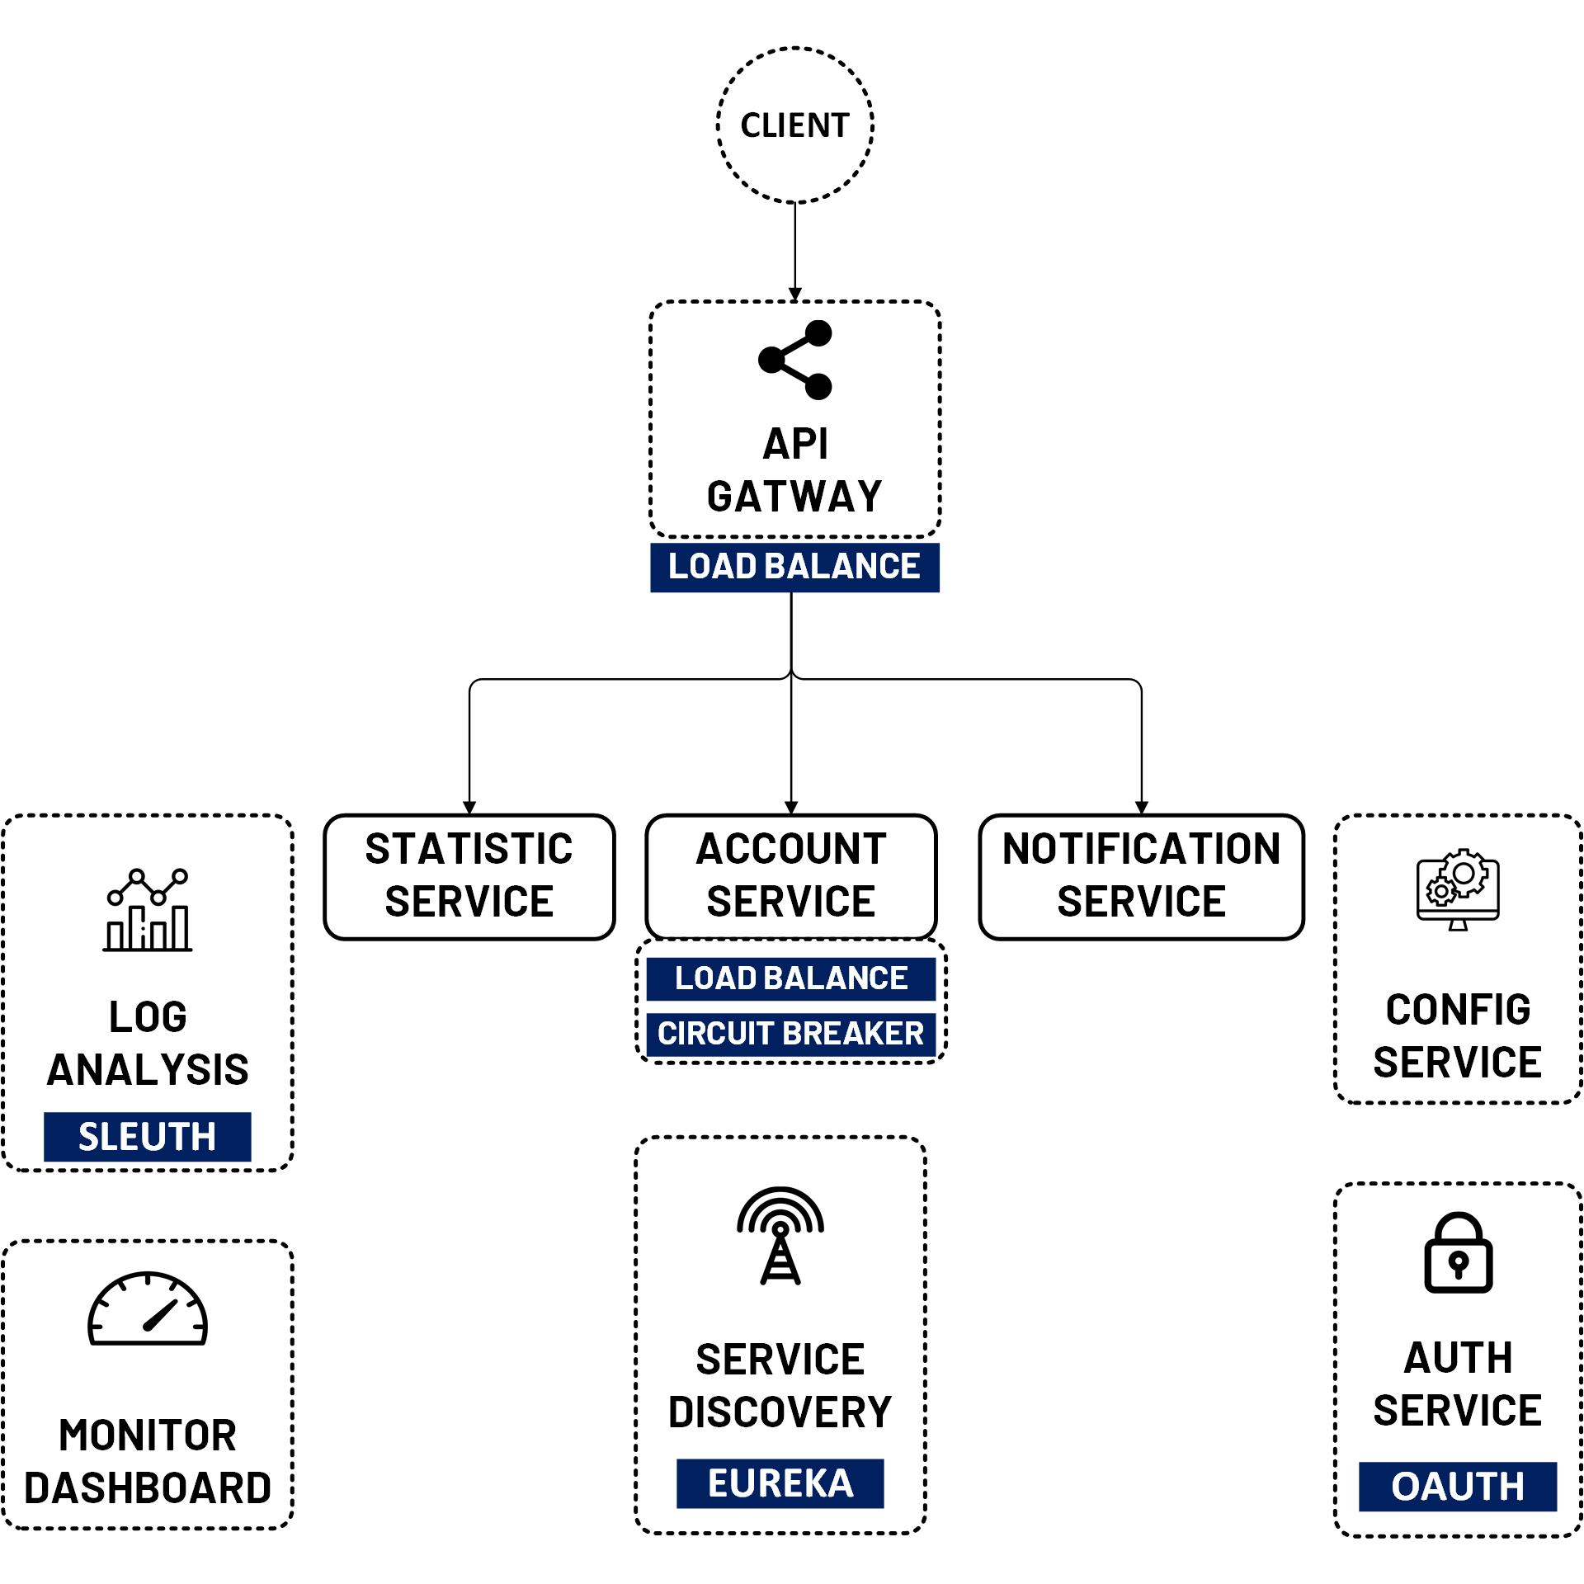

React JS CRUD API Gateway with JWT
www.jmaster.io/course/microservices-with-spring-cloud

